Slide 1
E-COMMERCE
Task - 1

Slide 2


E-commerce
LMS Username | Name | Batch
2113a53228 | DINESH N | A53
2113a53245 | LOKESH RAJA M | A53
2113a53234 | GURUSANKAR B | A53
2113a53214 | ANAND S | A53
2113a53230 | DONAVALLI SHANMUKA SAI | A53

Slide 3
INTRODUCTION
This Software Requirements Specification (SRS) document is a comprehensive overview of the
requirements for an ecommerce website. It defines the functional and non-functional requirements, as well as user expectations, for the website. The document also provides a detailed description of the website structure, its features, and user interaction. Additionally, the SRS outlines the performance goals of the website, as well as the development cycle from start to finish. This SRS should provide an effective guide for development of the website and its features.

Slide 4

Task - 1
Creation of SRS & Github
Create SRS : “Your Project”
Creation & Set-up of Github account
Creation & Hands-on to various commands of Git Bash
Evaluation Metric:
100% Completion of the above tasks
Learning Outcome
Get to know about different lifecycle models.
Understanding importance and how to create an SRS
Knowing various commands of Github
Understanding agile and scrum management techniques for efficient product development

Slide 5
Step-Wise Description
Step 1: Plan the Website: Before creating an e-commerce website for farmers, you need to plan the website by understanding the target audience, the purpose of the website, the products that will be sold, and other essential details.
Step 2: Choose the Right Platform: Once the plan is ready, you need to select the right platform for the e-commerce website. There are several e-commerce platforms available in the market such as Shopify, Magento, WooCommerce, etc.
Step 3: Design the Website: After selecting the platform for the website, you need to design the website. This includes creating a logo, choosing a template, and making the design user-friendly.
Step 4: Add Necessary Features: You need to add the necessary features to the website such as payment gateways, shipping options, tracking feature, product search, etc.
Step 5: Test the Website: Once the website is ready, you need to test the website to ensure that it is working properly and there are no bugs or errors.
Step 6: Launch the Website: After testing the website, you can launch the website. You can promote the website through social media, email marketing, and other means.

Slide 6
SUMMARY OF YOUR TASK:
Farmer ecommerce websites are websites that allow farmers to buy and sell goods online. These websites provide farmers with an easy and convenient way to access the products and services they need to run their business. These websites can offer a wide range of products, from farm equipment to livestock feed and more. Farmers can also use these websites to connect with other farmers, share resources, and find buyers for their products. These websites can help farmers expand their business and increase their profits.

Slide 7
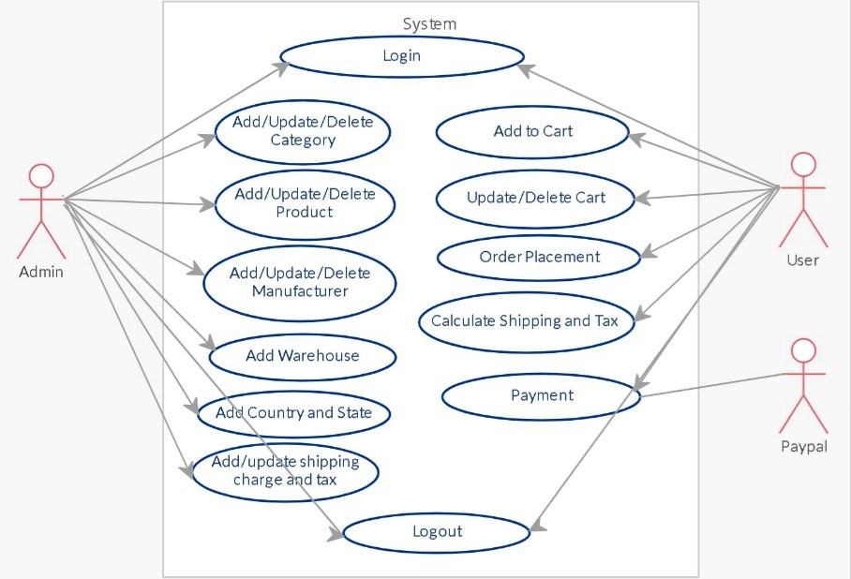
USE CASE DIAGRAM

Slide 8
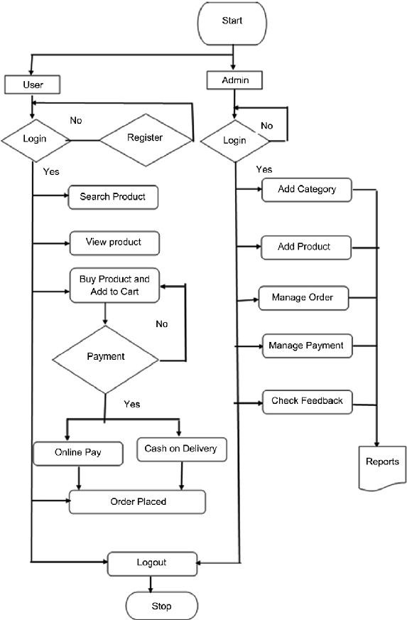
FLOW CHART

Slide 9
FUNCTIONAL REQUIREMENTS:
User Authentication: The system should support user authentication and authorization to ensure secure access to the system.
Shopping Cart: The system should allow customers to add, delete and modify items in their shopping cart.
Payment Gateway Integration: The system should provide integration with multiple payment gateways to accept payments from customers.
Product Catalog: The system should provide an extensive product catalog and search functionality for customers to browse and select items.
Order Management: The system should provide order management functionalities such as tracking, refunds, returns and cancellation of orders.
Inventory Management: The system should provide real-time inventory tracking and management capabilities.
Reports and Analytics: The system should provide reports and analytics to help merchants track and analyze sales, orders, customers and other key performance indicators.

Slide 10
NON FUNCTIONAL REQUIREMENTS
Performance: The e-commerce website should be able to process requests quickly with minimal latency.
Security: The e-commerce website should be capable of protecting user data and sensitive information.
Scalability: The e-commerce website should be able to handle sudden spikes in traffic and usage.
Availability: The e-commerce website should be available 24/7, with no downtime due to maintenance.
Reliability: The e-commerce website should be able to handle errors and unexpected conditions without crashing.
Usability: The e-commerce website should be user-friendly and intuitive to use.
Maintainability: The e-commerce website should be easy to modify and maintain.
Testability: The e-commerce website should be easy to test for bugs and other issues.

Slide 11


Assessment Parameter
Gather requirements for the
project
add Readme.md file with description of the project
Prepare database design
schemas
Check-List
Commit all changes with "first commit"
Get your initial project
Structure ready
create a repository on github realted to project
Initiate a git repository
Push your changes to github

Slide 12


https://github.com/Lokeshrajarit/Group_6_FSD_Batch_A53.git
Submission Github

Slide 13


